Slide 1
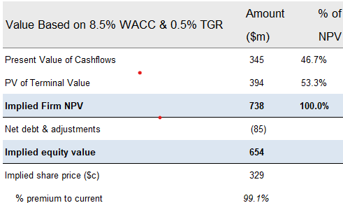
Provide an investment recommendation
Email to management
Hi Anna,
The 2021 fire acts as a major negative operational and financial shock. It transforms HappyHour Co. from a growing, profitable company into one that is shrinking, less profitable, burning cash, and taking on more debt in the short term.
The focus for management in FY21 would shift from growth to recovery, restructuring, and ensuring liquidity. The long-term impact depends on the adequacy of insurance proceeds (not detailed in the model) to cover the losses and the speed at which the company can restore its operations to pre-fire capacity and growth trajectories.
Also, Sensitising firm value ($m) and implied offer price to WACC and TGR also decreased to 739 / 329c from 803 / 361c .
The fire acts as a negative shock, introducing operational risk and depressing near-term financial performance. This shifts leverage in the negotiation to the bidders, who are likely to lower their offers and potentially introduce more complex, contingent deal structures to account for the increased uncertainty and perceived risk associated with the acquisition.
Investment recommended between:- 329-370mm each share.
As we can see from the image illustrated bellow. Changes in Implied firm NPV is 738 from 803 which is almost -8.73%.
Net present value based on perpetuity growth method
Preliminary valuation
Revised valuation (post-fire)
Value Based on 8.5% WACC & 0.5% TGR | Amount ($m) | % of NPV
Present Value of Cash flows | 409 | 50.9%
PV of Terminal Value | 394 | 49.1%
Implied Firm NPV | 803 | 100.0%
Net debt as of Mar-20E | (85)
Implied equity value | 718
Implied offer share price (c) | 361
% premium to current | 118.8%
Source: Company Business Plan (January 2020); Equity research; J.P. Morgan analysis
1

